Slide 1
Bagging ETS
Using STL and Box-Cox
經碩一劉仁豪
經碩一鄭仲恒

Slide 2
Content
Introduction
Method
Empirical data
Conclusions

Slide 3
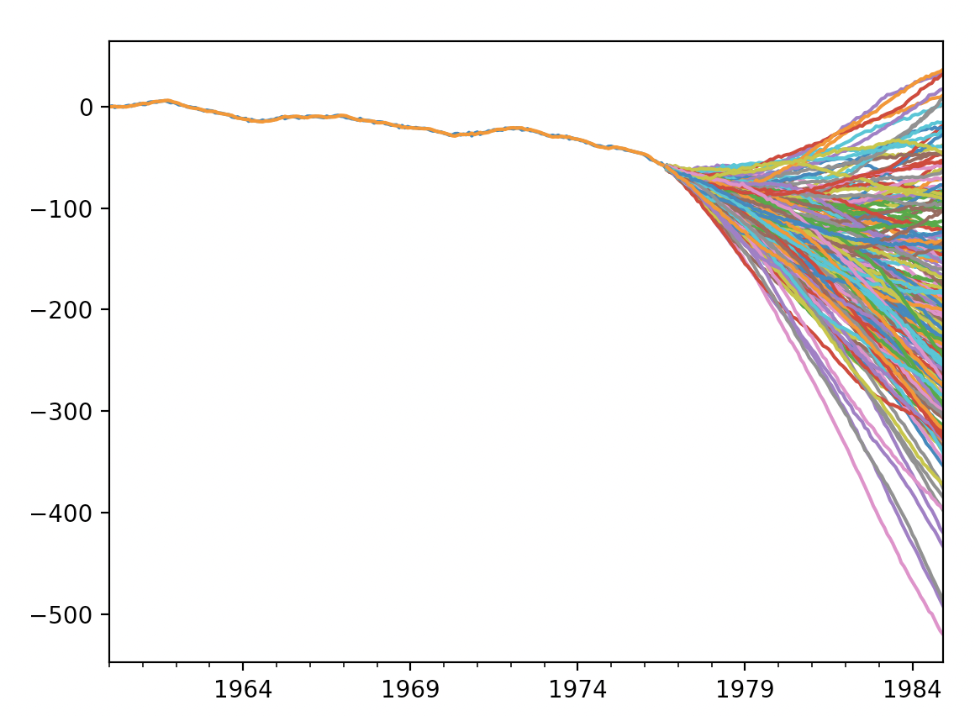
Introduction
DATA
FIT ETS
Choose the best model
Simulate

Slide 4
Introduction
To address the issues of:
Data uncertainty
Parameter uncertainty
Model uncertainty
Use Bootstrap aggregating (bagging)to improve the accuracy of predictor.

Slide 5
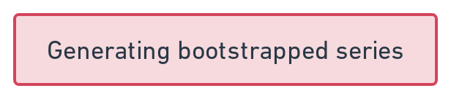
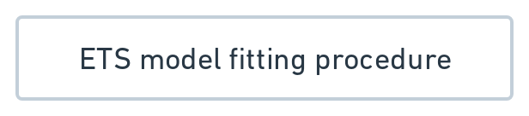



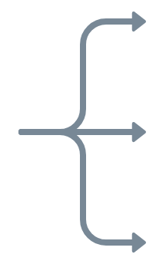





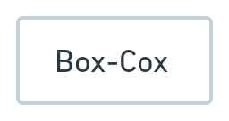
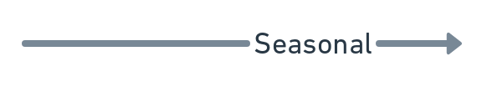
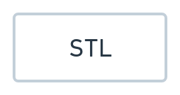



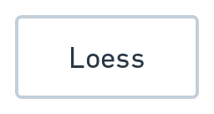
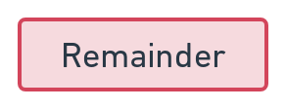






Introduction-Overall procedure
…
…
Notes:
Then, the best model is chosen using the bias- corrected AIC. We note that, of the 30 possible models, 11 can lead to numerical instabilities, and are therefore not used by the ets function (see Hyndman & Athanasopoulos, 2013, Section 7.7, for details). Thus, ets, as it is used within our bagging procedure, chooses from among 19 different models.

Slide 6
Method
Exponential smoothing
The Box-Cox transformation
Time series decomposition
Bootstrapping the remainder

Slide 7
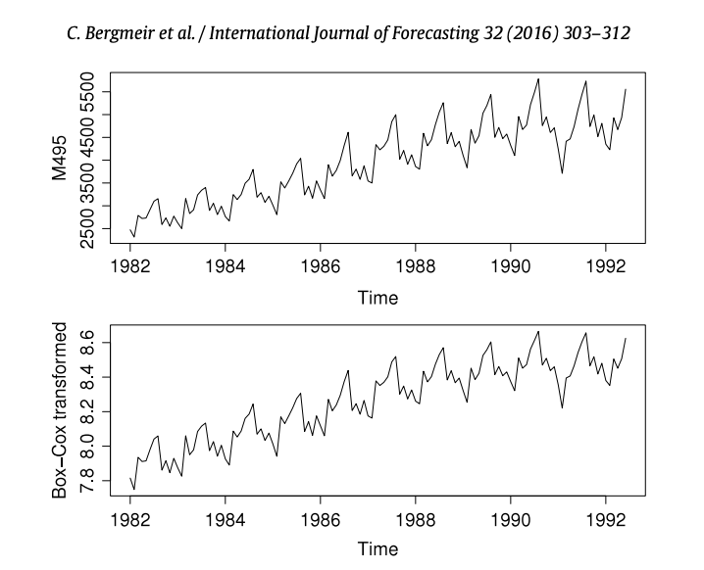
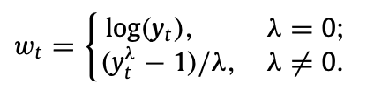
Box-Cox tranformation
A Box Cox transformation is a transformation of non-normal dependent variables into a normal shape.
In many cases, the underlying algorithm for the machine learning method apply in project assumes the data is approximately normal distributed
Effective method to improve robustness of model.
λ = 6.61 × 10^−5
Notes:
Depending on the parameter λ, the transformation is essentially the identity (λ = 1), the logarithm (λ = 0), or a transformation somewhere between.
One difficulty is the method of choosing the parameter λ. In this work, we restrict it to lie in the interval [0, 1],
then use the method of Guerrero (1993) to choose its value in the following way.

Slide 8
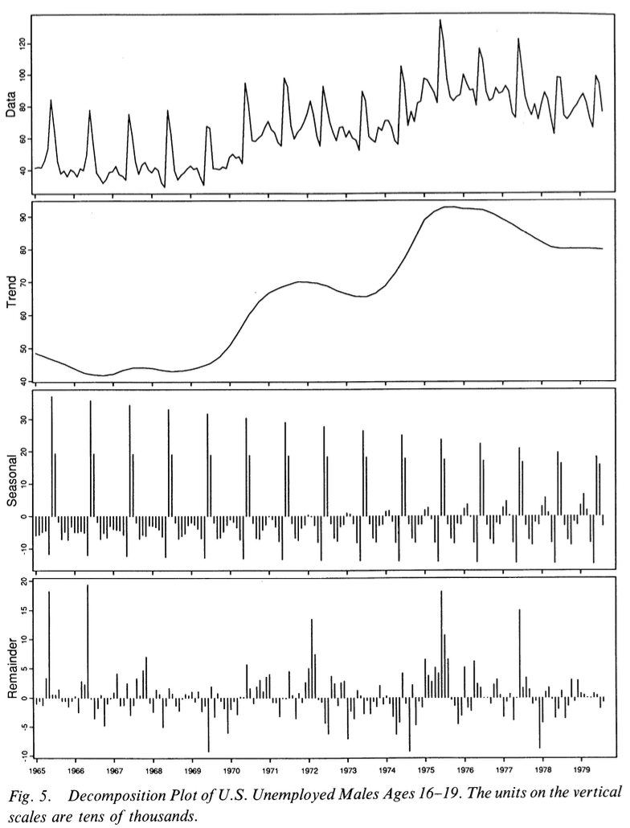
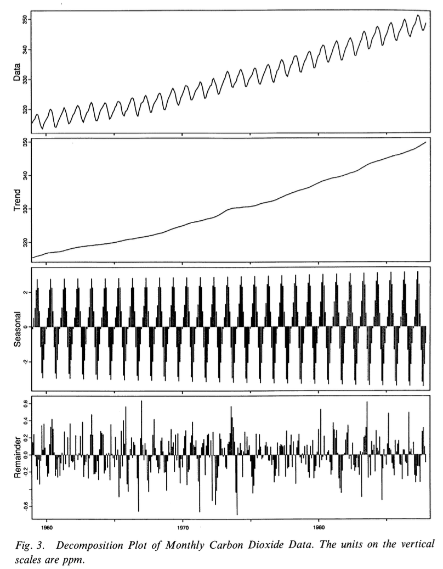
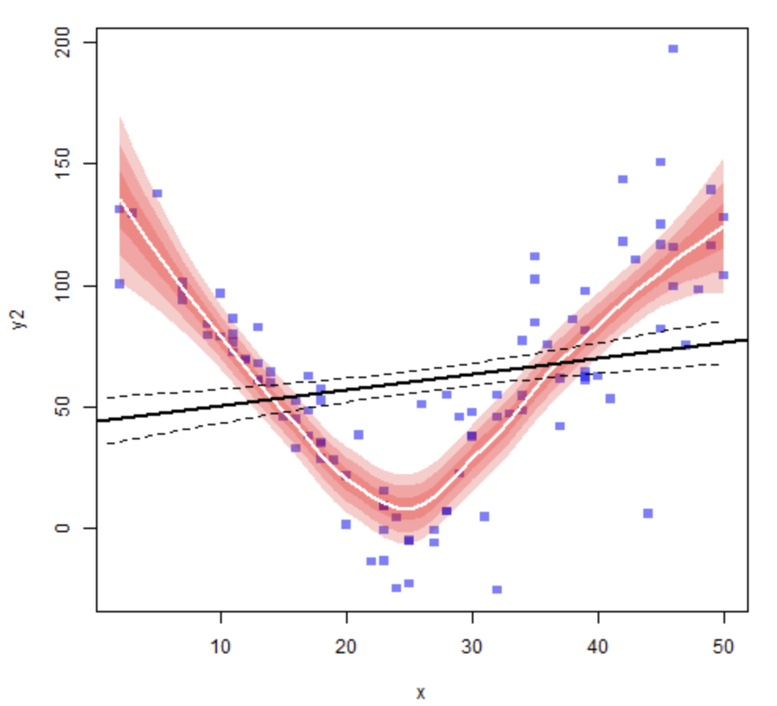
STL
Loess : Locally estimated scatterplot smoothing
STL consists of two recursive procedures:
Inner loop
Outer loop
6 parameters
np = number of observations in each cycle of the seasonal component
ni = number of passes through the inner loop,
no = number of robustness iterations of the outer loop
nl = smoothing parameter for the low-pass filter
nt = smoothing parameter for the trend component,
ns = smoothing parameter for the seasonal component
Post-smoothing of the seasonal
np = 12, ni = 1, no = 5, nl = 13, nt = 21, ns = 17
np = 12, ni = 2, no = 0, nl = 13, nt = 19, ns = 35
https://thomasleeper.com/Rcourse/Tutorials/localregression.html
Notes:
Loess, parameter : d, q，used to smoothing
STL used to devide trend and seasonal
To get a constant neighborhood of six data points with tricubic weighting.
STL consists of two recursive procedures:
Inner loop nested inside
Cycle-subseries
Low-Pass filter
Outer loop : Each pass of the outer loop consists of the inner loop followed by a computation of robustness weights these weights are used in the next run of the inner loop to reduce the influence of transient,aberrant behavior on the trend and seasonal components
Thus, ‘‘Simulating’’ an ETS process by decoupling the level, trend and seasonal components from the noise and treating them as independent series may not work well.
STL decomposition, in which the trend and seasonal components are smooth and the way in which they change over time does not depend on the noise component directly.
Therefore, we can simulate the noise term independently in an STL decomposition using bootstrapping procedures.

Slide 9
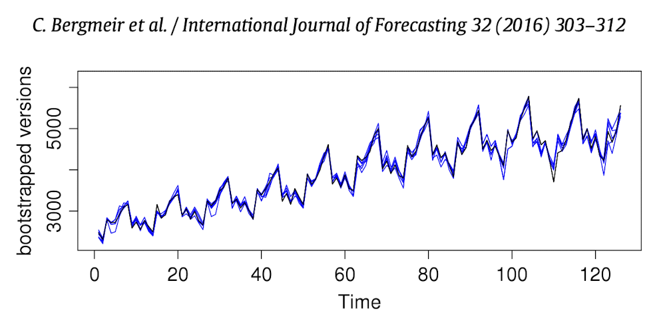
Bootstrapping the remainder(Moving Block Bootstrapping)
R1
R2
R3
R4
R5
R6
….
Rn-2
Rn-1
Rn
Remainder after decomposition
R1
R2
R3
R4
R5
R6
….
Rn-2
Rn-1
Rn
R1
R2
R3
R4
R5
R6
….
Rn-2
Rn-1
Rn
Block 1
R3
R4
R5
S1
R1
R2
R3
R4
R5
R6
….
Rn-2
Rn-1
Rn
R1
R2
R3
R4
R5
R6
….
Rn-2
Rn-1
Rn
R1
R2
R3
S2
Block 2
Random Draws
with replacement
Rn-2
Rn-1
Rn
+S+T =
S3
R1
R2
R3
R4
R5
R6
….
Rn-2
Rn-1
Rn
R1
R2
R3
R4
R5
R6
….
Rn-2
Rn-1
Rn
R2
R3
R4
S4
Block 3
…
…
…
…
R1
R2
R3
R4
R5
R6
….
Rn-2
Rn-1
Rn
Ri-2
Ri-1
Ri
Sn
R1
R2
R3
R4
R5
R6
….
Rn-2
Rn-1
Rn
Block n-2
Blocked remainders
Notes:
block sizes of l = 8 for yearly and quarterly data, and l = 24 for monthly data, i.e., at least two full years, to ensure that any remaining seasonality is captured.
For unstable procedure
The dependence in the data is tackled by fitting a model and then bootstrapping the residuals, assuming that they are uncorrelated.
This bootstrapping procedure has the disadvantage that one must assume that the model captures all of the relevant information in the time series.
The MBB has the advantage that it makes no modelling assumptions other than stationarity, whereas the sieve bootstrap assumes that the fitted model captures all of the serial correlation in the data.

Slide 10
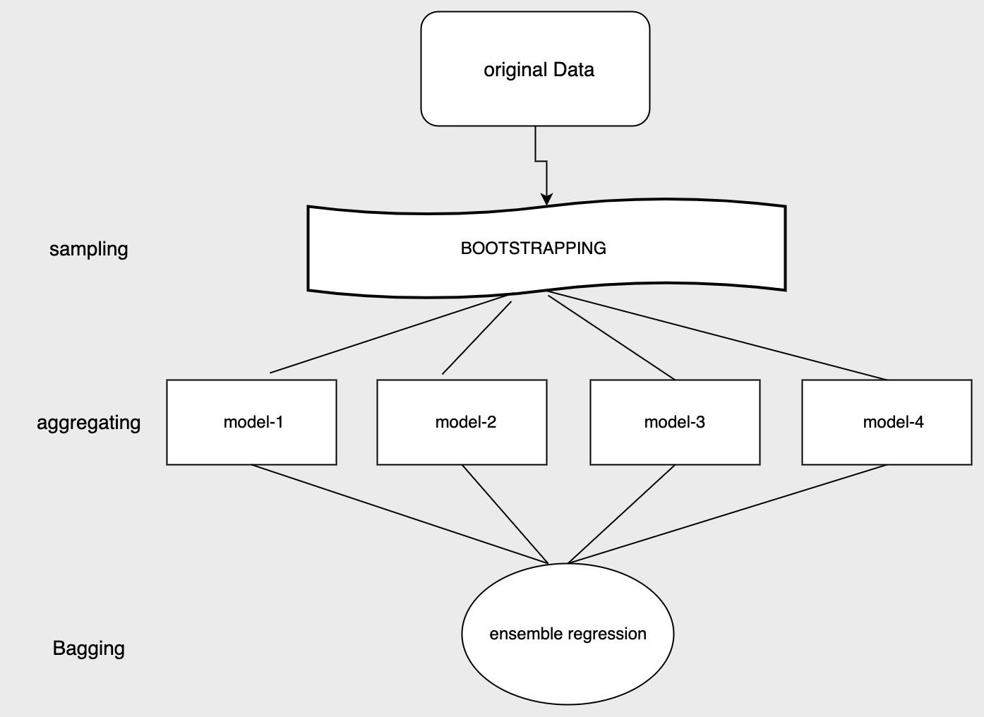
Emprical data
compared method
Bagged(bootsrapping aggerating)：one of method in Ensemble Learning
BLD(BoxCox transfomation + STL or Loess)
MBB&Sieve bootsrap for remainder
what is Sieve bootstrap
selecting the order p=p(n) of an AR approximation using AIC
AR model filter the residsual series obtain empirical CDF
resampling
obtain a new series
compute the AR coeffiicients obtain new series
Bagged.BLD.MBB.ETS
Bagged.ETS.Sieve.ETS
Bagged.BLD.Sieve.ETS
Bagged.ETS.MBB.ETS
Notes:
是機器學習領域的一種集成學習算法。最初由Leo Breiman於1994年提出。Bagging算法可與其他分類、回歸算法結合，提高其準確率、穩定性的同時，透過降低結果的變異數，避免過擬合的發生。
Ensemble Learning基本條件是:每個分類器之間應該要有差異，每個分類器準確率需大於0.5。
如果用的分類器沒有差異，那只是用很多個一樣的分類器來分類，結果合成起來是沒有差異的。如果分類器的精度p<0.5，隨著ensemble規模的增加，分類準確率不斷下降；如果精度大於p>0.5，那麼最終分類準確率可以趨向於1
Bagging概念很簡單，從訓練資料中隨機抽取(取出後放回，n<N)樣本訓練多個分類器(要多少個分類器自己設定)，每個分類器的權重一致最後用投票方式
Bagging的優點在於原始訓練樣本中有噪聲資料(不好的資料)，透過Bagging抽樣就有機會不讓有噪聲資料被訓練到，所以可以降低模型的不穩定性。
Advantages:
Many weak learners aggregated typically outperform a single learner over the entire set, and has less overfit
Removes variance in high-variance low-bias weak learner ^{[15]}
Can be performed in parallel, as each separate bootstrap can be processed on its own before combination^{[16]}
Disadvantages:
For weak learner with high bias, bagging will also carry high bias into its aggregate^{[15]}
Loss of interpretability of a model.
Can be computationally expensive depending on the data set

Slide 11
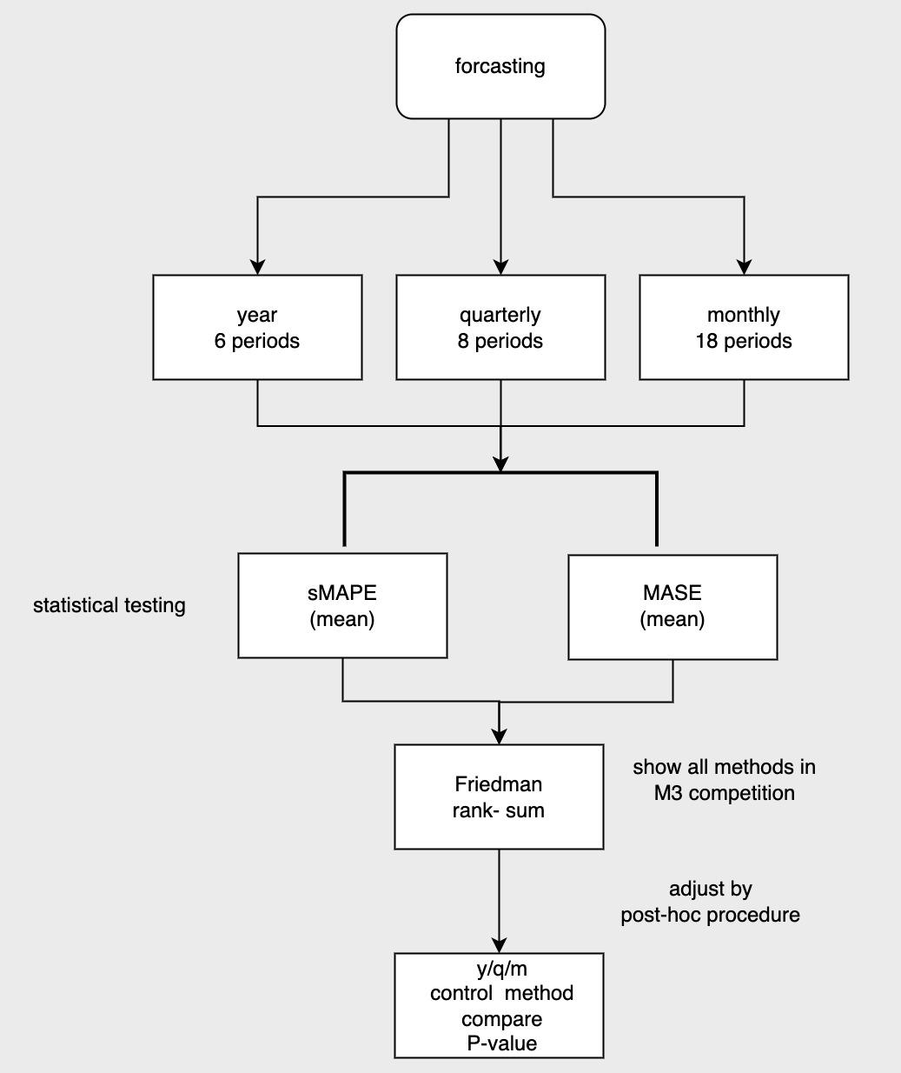
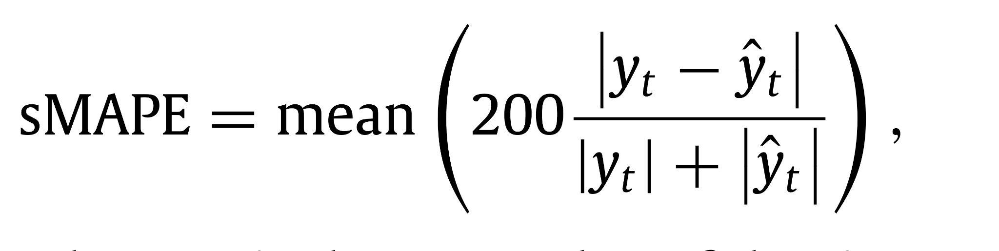
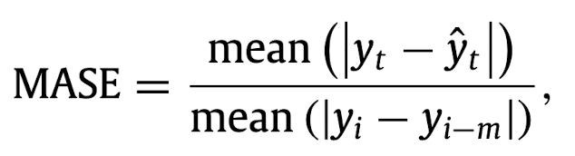
Evalutaion methodology
smape( Mean Absolute Percentage Error)
Expressed as a percentage
Fixes the shortcoming of the original MAPE (smape range from (0%) to (200%) bounds)
mase(mean absolute scaled error)
mean absolute error on the test set ,scaled by the mean absolute error of benchmark metod on the training set
Notes:
基本上可以視為 Mean Absolute Percentage Error（MAPE）的某種改良（因為 MAPE 對於預測值高於實際值的情況沒有預測『上限』，低於的情況卻有），所以會被稱為『對稱性』（Symmetric）此評估指標多用於迴歸問題而非分類問題。
平均絕對比例誤差 (MASE)
用於模型精確度的誤差測量。 它是由樸素模型的 MAE 劃分的 MAE。 單純模型是將時間點 t 的值預測為前一個歷程值的模型。 透過此誤差進行縮放調整意味著您可以評估該模型與樸素模型相比的品質程度。 如果 MASE 大於 1，則該模型會比樸素模型更差。 MASE 越低，與樸素模型相比，該模型越好。
定義為測試集上的平均絕對誤差，縮放
通過基準方法的平均絕對誤差
訓練集。 天真的預測被用作基準，
考慮到數據的季節性。 就這樣
MASE 定義為

Slide 12
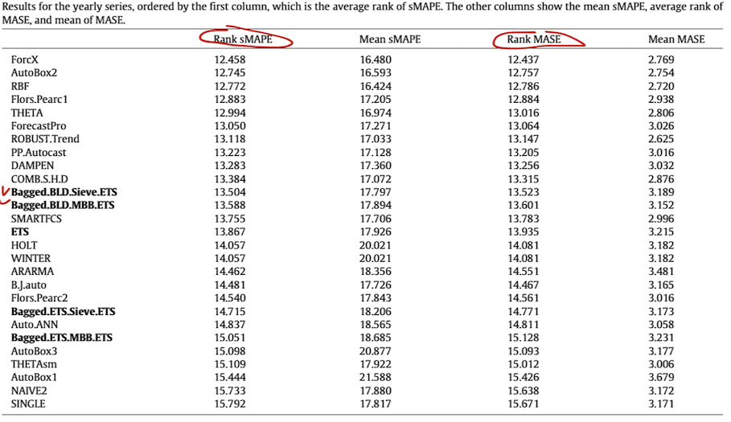
Year data
method | p-value
Bagged.BLD.sieve.ETS(control variable) | X
ETS | 0.438
Bagged.BLD.MBB.ETS | 0.438
Bagged.ETS.Sieve.ETS | 0.034
Bagged.ETS.MBB.ETS | 0.0000395
(level of significance 0.05)

Slide 13
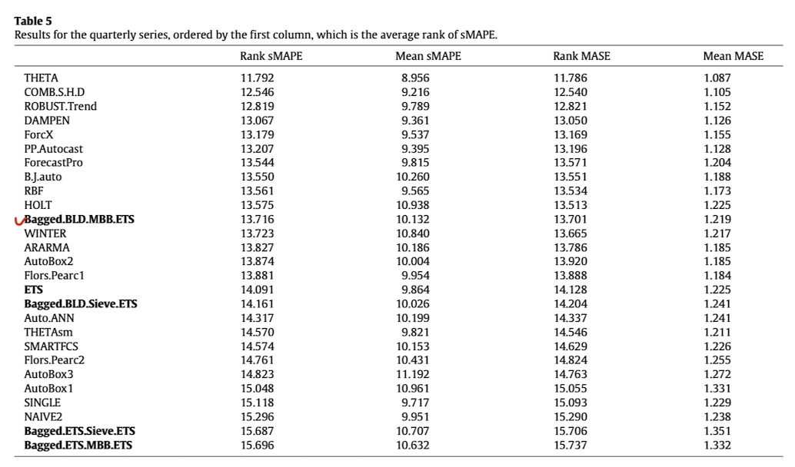
Quarterly
method | p-value
Bagged.BLD.MBB.ETS(control variable) | X
ETS | 0.354
Bagged.BLD.Sieve.ETS | 0.147
Bagged.ETS.Sieve.ETS | 6.94X10^-7
Bagged.ETS.MBB.ETS | 5.00X10^-8
(level of significance0.05)

Slide 14
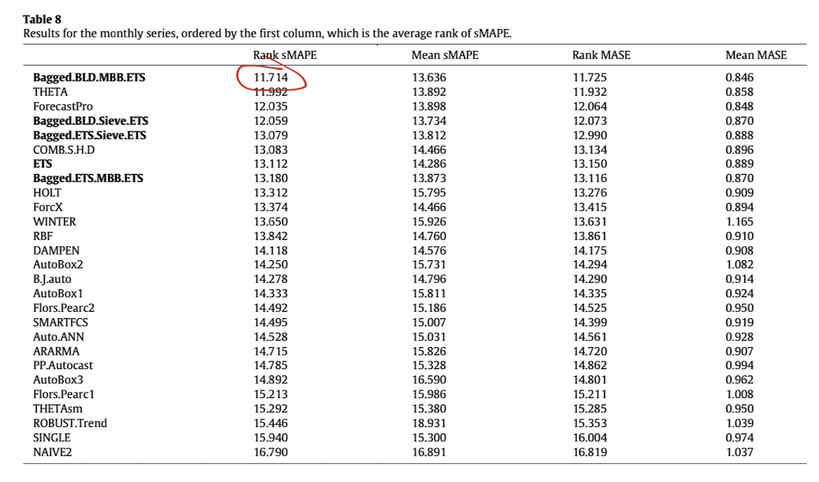
Monthly
method | p-value
Bagged.BLD.MBB.ETS(control variable) | X
Bagged.BLD.SIeve.ETS | 0.338
Bagged.BLD.Sieve.ETS | 3.70X10^-6
ETS | 4.32X10^-8
Bagged.ETS.MBB.ETS | 5.17X10^-11
(level of significance 0.05)

Slide 15
Conclusion
Bagged.BLD.MBB.ETS
1.statistically significant in the monthly series
2.NOT statistically significant in the year/quarterly
why?
the monthly series is much longer (18 preiods), tests with greater power
the year/quarterly series are too short for the differences
Notes:
統整 重點和其他方式比較是ＭＢＢ法的更好

Slide 16
References＆Recommending Papers
Bagging Predictors
Bbeiman L(1996) 123-140
FORECASTING TIME SERIES WITH BOOT.EXPOS PROCEDURE
*Cordeiro C, Neves M(2009) 135-149
STL:A Seasonal-Trend Decomposition Procedure Based on Loess
Robert B. Cleveland Journal of official Statistics (1990) vol.6
Air transportation demand forecast through Bagging Holt Winters methods
Dantas T, Cyrino Oliveira F, Varela Repolho H
Journal of Air Transport Management (2017) 59 116-123
Forecasting mid-long term electric energy consumption through bagging ARIMA and exponential smoothing methods
de Oliveira E, Cyrino Oliveira F
Energy (2018) 144 776-788
Improving time series forecasting: An approach combining bootstrap aggregation, clusters and exponential smoothing
Dantas T, Cyrino Oliveira F
International Journal of Forecasting (2018) 34(4) 748-761
連結

